Slide 1

CAREFLOW – CLINICAL PATHWAY PROCESS MINING (MID-Review)
Team Members
Anagha S Pillai
Yashaswini N P
Vaishnavi Dipak Bhagat
Infotact Solutions – Data Analytics Internship

Slide 2

Introduction
CareFlow is a process-mining project built to understand patient journeys through hospital workflows using timestamped event logs.
Traditional dashboards provide aggregated KPIs (patient counts, activity counts, average wait/processing times) but can obscure the true sequence of activities, repeated steps, loop-backs, and deviations experienced by individual patients.
CareFlow uses event logs to discover actual workflows, quantify repeated activities, analyze transitions and waiting times, perform conformance checking against an expected pathway, and surface process-oriented insights via a Power BI dashboard.

Slide 3

Problem statement and project objectives
Problem Statement
Hospital workflows involve multiple activities, but traditional dashboards mainly show numerical KPIs and may not reveal how patients actually move through the process.
Patients may experience:
Repeated activities & loop-backs
Different activity sequences
Waiting-time delays
Deviations from the expected workflow
Example:
Triage → X-Ray → Triage
This repeated activity indicates a potential process inefficiency requiring investigation.
Project Objectives
Analyze and clean timestamped patient event data
Discover actual patient workflows using PM4Py
Identify bottlenecks, loops, transitions & waiting times
Generate DFG and Petri Net process models
Compare actual vs expected patient journeys using conformance checking
Visualize findings through an interactive Power BI dashboard
Provide process-oriented insights that can support further hospital workflow investigation.

Slide 4

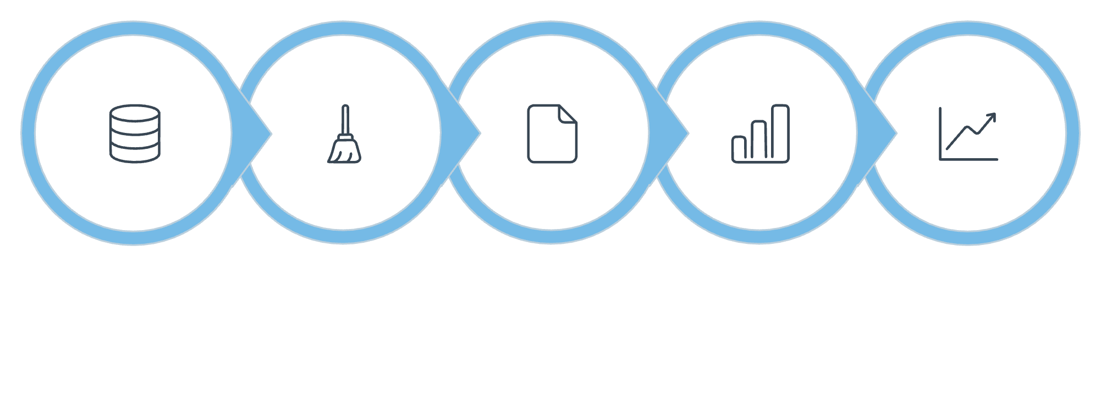
Project
Workflow
Hospital Event Data
↓
Data Generation
↓
Data Cleaning & Transformation
↓
Event Log Preparation
↓
Exploratory Data Analysis
↓
Repeated Activity & Process Analysis
↓
Waiting-Time Analysis
↓
PM4Py Process Discovery
↓
DFG + Petri Net
↓
Conformance Checking
↓
Power BI Dashboard
↓
Consolidated Process Insights
Event
Data
Data
Cleaning
Event
Log Prep
Exploratory
EDA
Process
Discovery

Slide 5

Technology Stack
Technologies Used in CareFlow
Technology | Purpose
🐍 Python | Event-log generation & processing
🐼 Pandas | Data cleaning & analysis
📊 Matplotlib | Basic EDA visualization
📄 CSV | Event-log storage
🔬 PM4Py | Process discovery & conformance analysis
🔗 Graphviz | Process-map visualization
📈 Power BI | Interactive dashboard
🌐 Git & GitHub | Version control & collaboration
Deferred Technologies
BigQuery and dbt were evaluated as possible additions to the project architecture.For the current implementation, the team decided to defer both technologies.The decision was made to keep the project focused on the core process-mining workflow.

Slide 6

Data Preparation & Cleaning
Event Log Generation
Data Cleaning
The simulated event log uses a Python-based generator.
Each event contains:
  Case_ID → Patient process case
  Activity_Name → Hospital activity
  Timestamp → Activity time
Dataset includes both normal paths and process loop-backs
Example:
Normal Path
Triage → X-Ray → Doctor Consult →Discharge
Observed Loop
Triage → X-Ray → Triage
Data Cleaning
clean_events.py prepares the event log for EDA and PM4Py by performing:
Missing-value checking
Timestamp validation
Duplicate checking
Data standardization
Event-log preparation
Dataset After Cleaning
Metric | Value
Patient Cases | 200
Recorded Events | 873
Cleaned Events | 873
Rows Removed | 0

Slide 7

EDA & Initial Findings
Exploratory Data Analysis
Initial Findings
200 patient cases
873 recorded events
36.5% repeated Triage pattern
Key observation:
Triage → X-Ray → Triage
This loop-back was identified as an important pattern for further bottleneck and process analysis.
EDA was performed to understand the structure and behaviour of the hospital event log.
Analysis performed:
Dataset overview
Number of patients and events
Activity distribution
Average events per patient
Repeated Triage activity analysis
Triage → X-Ray → Triage loop-back analysis
X-Ray → Triage waiting-time analysis
Activity visualizations

Slide 8

Bottleneck & Waiting-Time Analysis
Waiting-time Analysis
Bottleneck Analysis
The initial EDA identified a repeated process pattern:
Triage
↓
X-Ray
↓
Triage
A total of:
73 out of 200 patients experienced this loop.
This represents: 36.5% of patient cases
The Triage → X-Ray → Triage pattern was therefore identified as the primary process bottleneck requiring further investigation.
Note: The repeated Triage pattern is treated as an observed process deviation and potential bottleneck. The underlying operational/root cause has not yet been confirmed.
Waiting-time analysis was performed to understand the time spent between consecutive hospital activities.
Particular attention was given to transitions associated with the identified bottleneck, including:
X-Ray → Triage
The analysis also considered important transitions such as:
Triage → X-Ray
X-Ray → Triage
Triage → Doctor Consultation
Doctor Consultation → X-Ray
Waiting-time analysis complements bottleneck analysis by considering both the frequency of process transitions and the time associated with movement between activities.

Slide 9

PM4Py Process Discovery
From Data Analysis to Formal Process Mining
PM4Py was introduced to move from manual Pandas-based process analysis to formal process discovery and to discover the actual patient workflow from the cleaned event log.
The process discovery implementation successfully generated:
Directly-Follows Graph (DFG)
Petri Net process model
Process-map visualizations
Process Discovery Workflow
Cleaned Event Log
↓
PM4Py
↓
Process Discovery
↓
DFG + Petri Net
Why PM4Py?
Automatically discovers activity sequences
Represents actual patient flow
Reveals frequent transitions
Helps identify loops and process variations
Provides a formal process model
Status
✅ Successfully executed and verified from a fresh clone

Slide 10

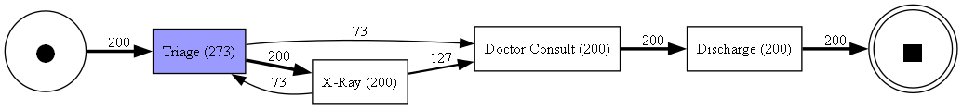
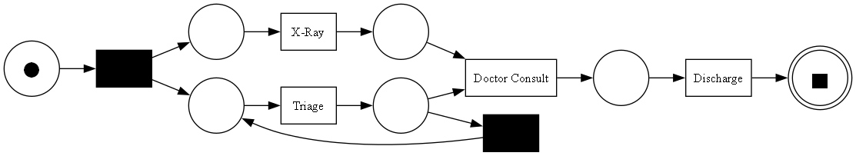
PM4Py Outputs: DFG & Petri Net
1. Directly-Follows Graph (DFG)
2.Petri Net Process Model
The DFG represents activity-to-activity transitions in the patient journey.
It helps us identify:
Common transitions
Process paths
Transition frequencies
Loop-backs
Potentially unusual transitions
Example: Triage → X-Ray → Triage
A Petri Net process model was generated using PM4Py.
The model provides a structured representation of the discovered patient workflow and helps visualize:
Activities
Transitions
Process paths
Repeated process behavior
Possible deviations
The generated Petri Net was successfully verified during the PM4Py workflow testing.

Slide 11

Conformance Checking
Conformance checking was performed to compare actual patient journeys against the expected hospital pathway.
The reference pathway used for the analysis was:
Triage
↓
X-Ray
↓
Doctor Consult
↓
Discharge
Method
Each of the 200 patient cases was compared with the expected pathway.
A case is conformant when its activity sequence exactly matches the defined ideal path.
Additional/repeated activities result in a deviating case.
Purpose
Conformance checking identifies:
Process deviations
Repeated activities

Slide 12

Conformance Findings & Results
Conformance Results
Category | Cases | Percentage
🟢 Conformant | 127 | 63.5%
🔴 Deviating | 73 | 36.5%
Total | 200 | 100%
Key Interpretation
63.5% of cases followed the defined ideal pathway.
36.5% of cases deviated from the expected pathway.
Major observed pattern
Triage → X-Ray → Triage
The 73 deviating cases align with the repeated Triage pattern identified during EDA and process analysis.
Key takeaway
The same 36.5% pattern is observed across multiple stages of analysis.

Slide 13

Power BI Dashboard
Dashboard Purpose:
Converts process-mining results into an interactive visual interface for monitoring patient flow.
Main dashboard sections:
Patient Overview
Total cases
Activity counts
Process Performance
Average waiting time
Transition analysis
Conformance
Conformant cases
Deviating cases
Conformance split
Process Analysis
Activity flow
Process map
Repeated activity patterns

Slide 15
Conclusion
CareFlow progressed from data preparation to process discovery, conformance checking, and Power BI dashboard development.
Identified key bottleneck: Triage → X-Ray → Triage, affecting 73/200 cases (36.5%).
63.5% conformant and 36.5% deviating patient cases were identified.
Power BI integrates KPIs, activity analysis, conformance, and waiting-time insights.
BigQuery and dbt are deferred to focus on validating the core process-mining workflow.
The final solution will help identify inefficient patient-flow patterns and areas for improvement.

Slide 16

Thank you

